Slide 1

KAĞAN ÖZASLAN CFO

Slide 2
Video Transmission
Command Transmission

Slide 3
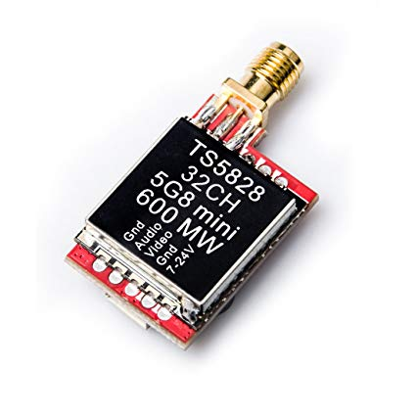
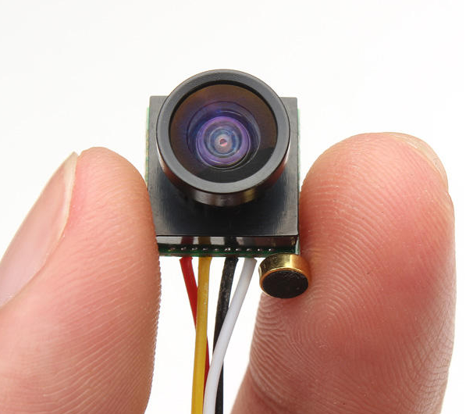
Video Transmission
5.8 Ghz
600mw Transmitter (TS5828)
40 Channel
27.5 dBm
170 degree camera

Slide 4
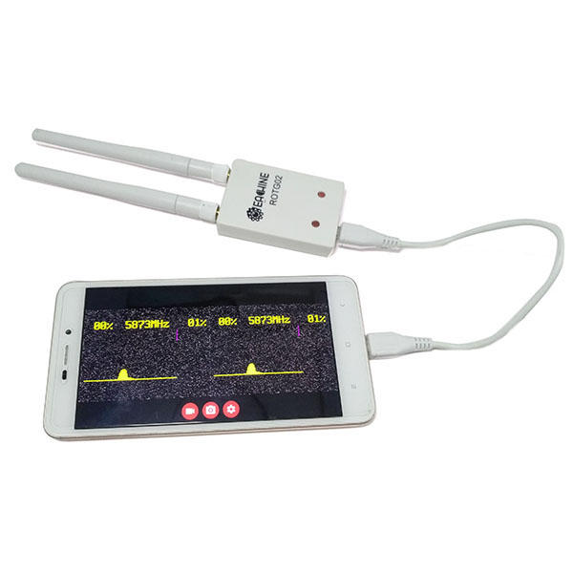
Video Transmission
5.8 Ghz Receiver (ROTG02)
Easy to use
Plug and Play with usb cable
150 Channel

Slide 5
Test Results
Outdoor = 500 m
Indoor = 50 m (from E Building Top Floor to D Building Study Hall)

Slide 6
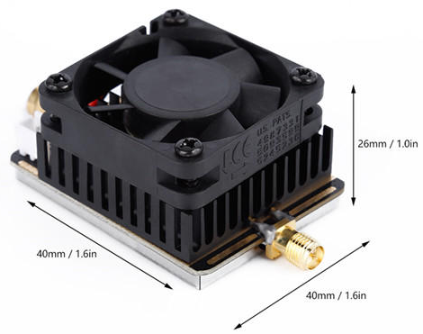
Test Results
Outdoor = 500 m
Indoor = 50 m (from E Building Top Floor to D Building Study Hall)
Improvement Option
5.8G Amplifier
27dBm to 34 dBm

Slide 7
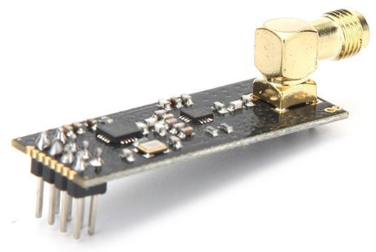
Command Transmission
2.4Ghz band
NRF24L01+ module
Very cheap (less than $2)
Compatible with high gain antennas
2.4ghz antennas are also very cheap
Secure communication protocol
100mW, legal to use

Slide 8
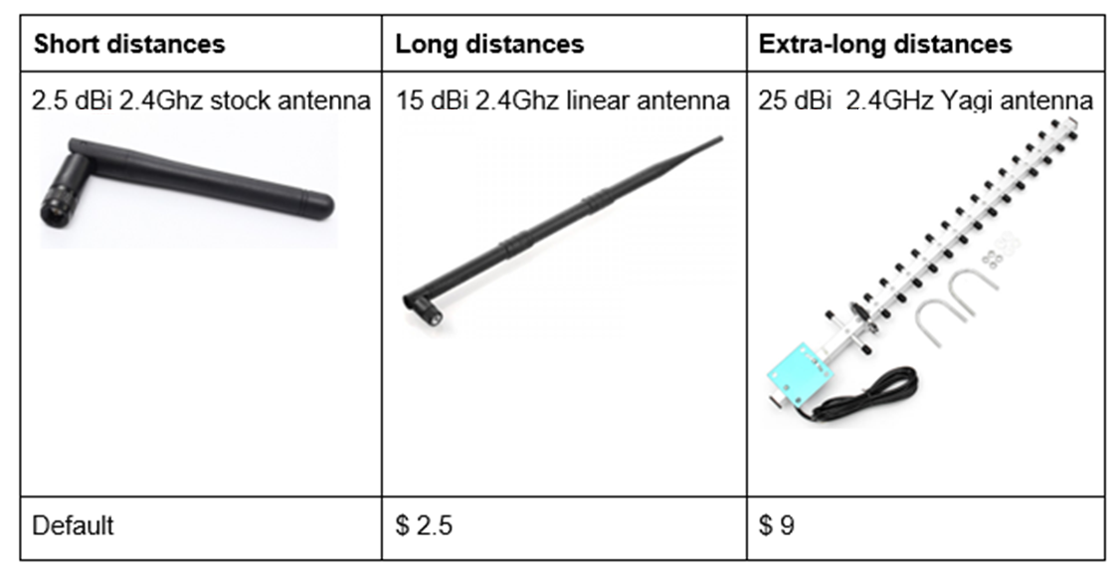
Command Transmission

Slide 9
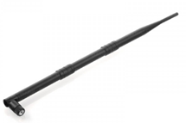
Test Results
NRF modules with 15dBi Linear Antennas
Outdoor = 1 km
Indoor = 100 m

Slide 10
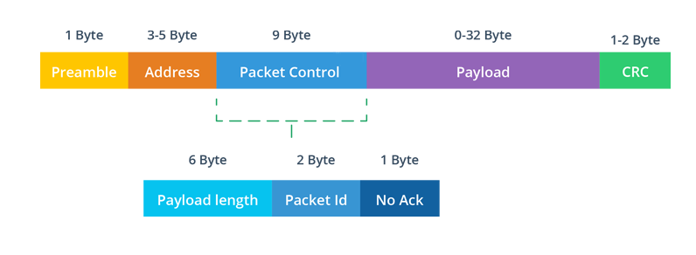
Communication Protocol

Slide 11
Preamble: Shows beginning of a packet.
Address: Shows the network pipe address.
Packet Control: Settings section.
Payload: Sending data is stored inside. Upon 32 byte.
CRC: Cyclic redundancy check for error detection.

Slide 12
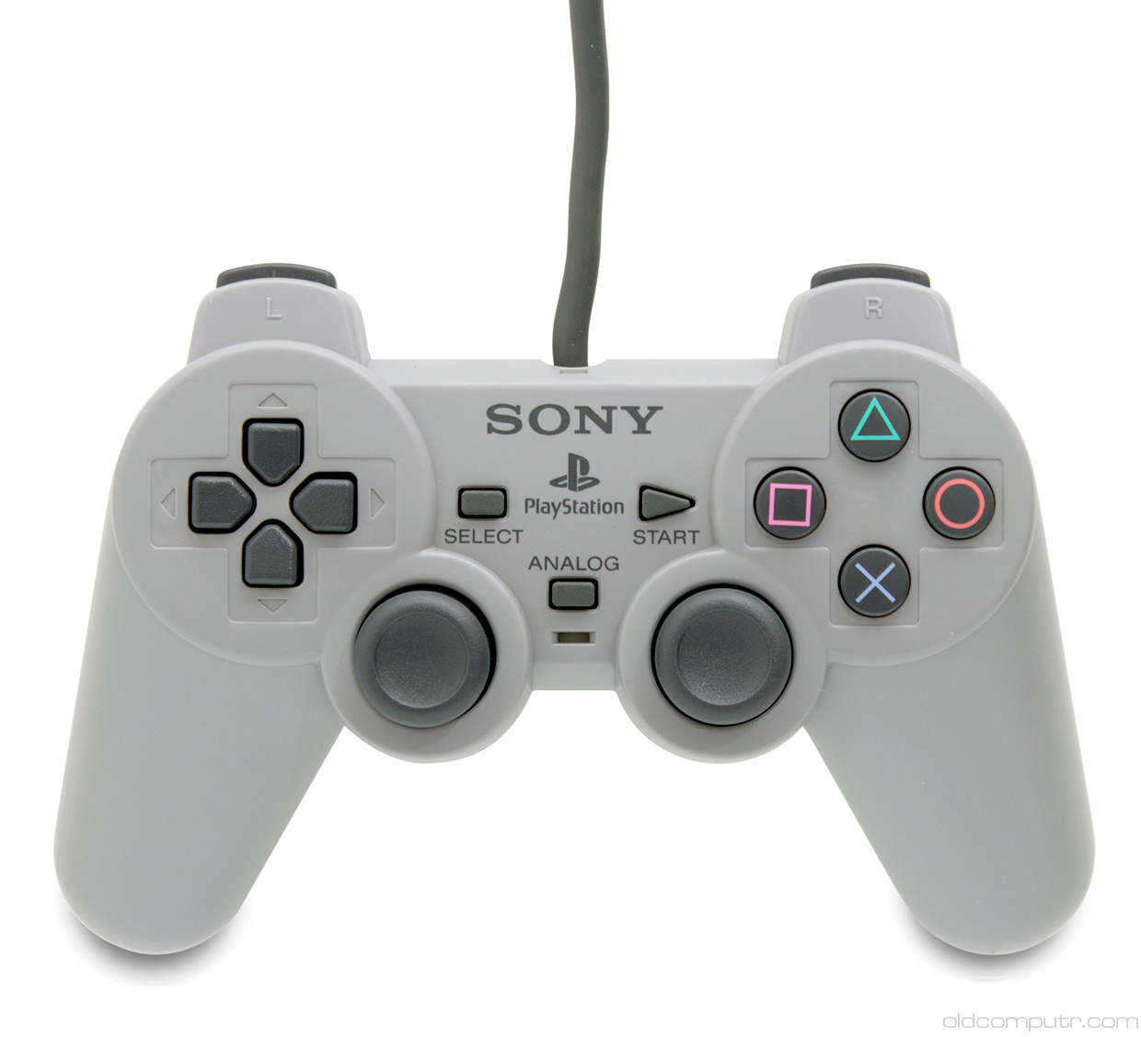
User Side

